Slide 1


Noida Institute of Engineering and Technology, Greater Noida
Data Link layer
Unit: 2
Computer Networks (ACSE502)
Ms. Ibtesaam Rais
Assistant Professor
CSE(IoT) Department
B Tech CSE(IoT)
5th Sem

Slide 2
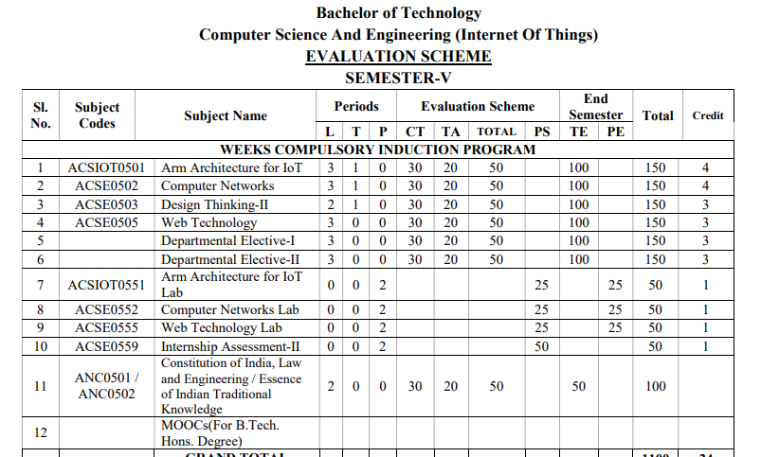
Curriculum

Slide 3

Syllabus

Slide 4
Books
Text books:
Behrouz Forouzan, “Data Communication and Networking” Fourth Edition-2006, Tata McGraw Hill
Andrew Tanenbaum “Computer Networks”, Fifth Edition-2011, Prentice Hall.
William Stallings, “Data and Computer Communication”, Eighth Edition-2008, Pearson.
Reference Books:
Kurose and Ross, “Computer Networking- A Top-Down Approach”, Eighth Edition-2021, Pearson.
Peterson and Davie, “Computer Networks: A Systems Approach”, Fourth Edition-1996, Morgan Kaufmann

Slide 5
Course Objective
Objective of this course is to develop an understanding of computer networking basics, different components of
computer networks, various protocols, modern technologies and their applications.

Slide 6
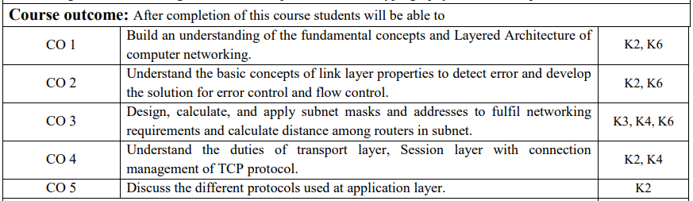
Course Outcome

Slide 7
PO’s
1.Engineering knowledge
2. Problem analysis
3. Design/development of solutions
4. Conduct investigations of complex problems
5. Modern tool usage
6. The engineer and society
7. Environment and sustainability
8. Ethics
9. Individual and team work
10. Communication
11. Project management and finance
12. Life-long learning

Slide 8
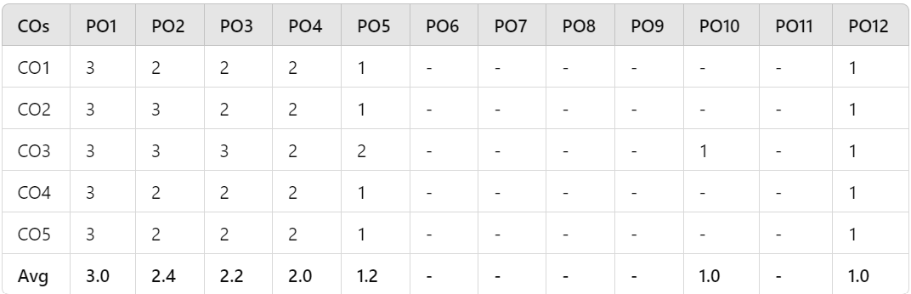
CO-PO Mapping

Slide 9
PSO’s
Program Specific Outcomes (PSOs) are what the students should be able to do at the time of graduation. The PSOs are program specific. PSOs are written by the department offering the program.
On successful completion of B. Tech. CSE(IoT) Program, the graduates will be able to:
PSO1:Apply concept of IoT to solve real world problems for societal wellbeing by leveraging latest tools.
PSO2: Work as an individual or lead as a team with good communication and engage in life-long learning.
PSO3: Apply ethical principles as a successful professional, entrepreneur, and pursue higher education.

Slide 10
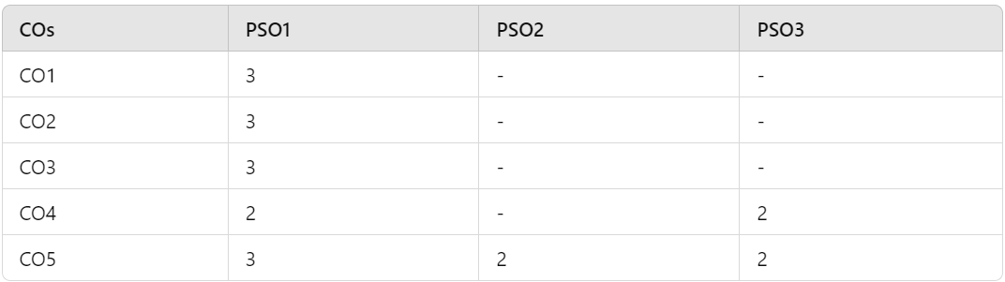
PSO’s

Slide 11
Program Educational Objectives
The Program Educational Objectives (PEOs) of an engineering degree program are the statements that describe the expected achievements of graduates in their career, and what the graduates are expected to perform and achieve during the first few years after graduation.
PEO1: Engage in designing, manufacturing/fabricating, and maintaining smart systems in the field of IoT.
PEO2: Solve problems of social relevance through applying the knowledge of basic science, IoT and pursue higher education and research.
PEO3: Engage in life-long learning, career enhancement, and be able to adapt to dynamic needs of profession and society.
PEO4: Work as an individual and as a team member in multidisciplinary projects with effective communication.

Slide 12
Result Analysis
Session | Overall % Result of Subject | Highest Marks | Average Marks
2023-2024 | 90.2 | 131 | 86.83

Slide 13
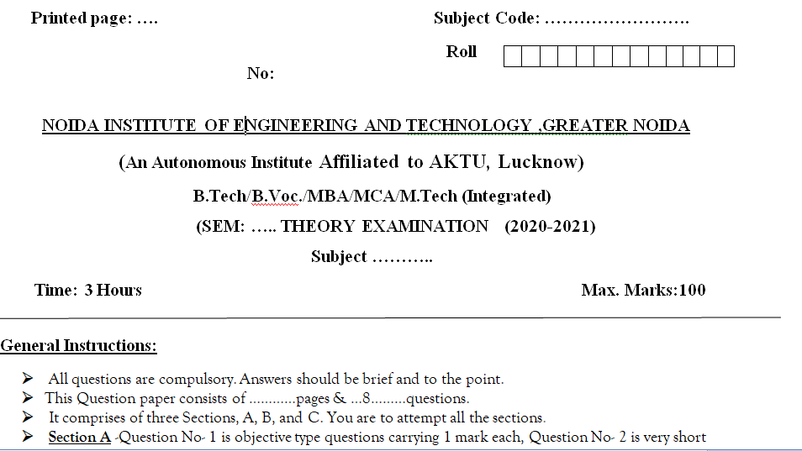
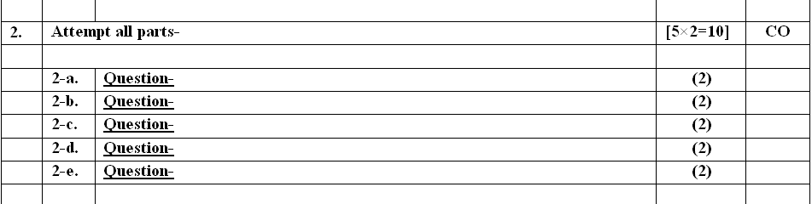
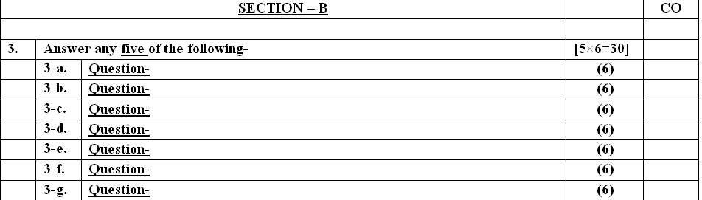
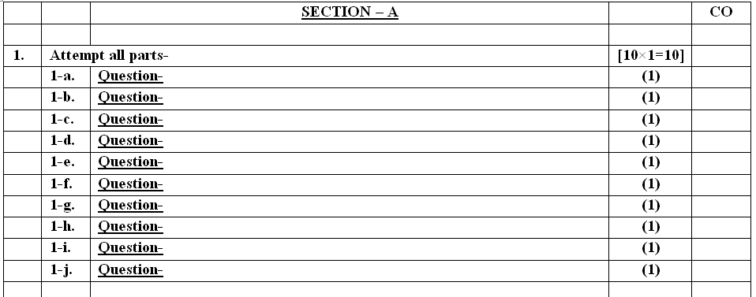
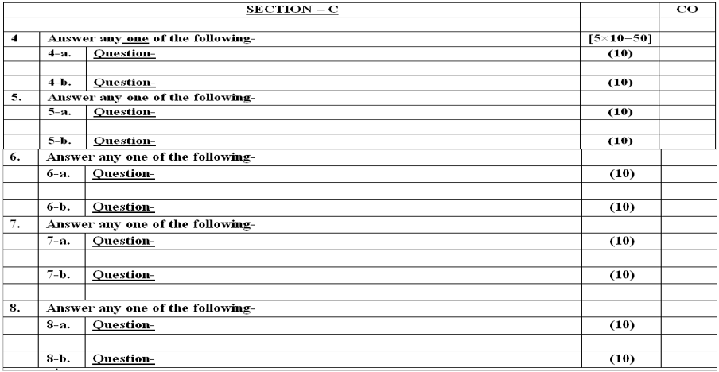
End semester Question paper templates

Slide 14
Prerequisite and Recap
Fundamental of computer
Types of Network and OSI Model, TCP/IP Model
Encoding
Packet switching

Slide 15
Content
Functions of data link layer
Sub layers of data link layer
Project 802
PDU format
MAC frame
IEEE LAN standards
Ethernet
Token Ring
FDDI
DQDB
Data Link Layer Protocols
Multiple Access Protocol
Flow control
Error control

Slide 16
Unit Objective
The objective of this course is to understand the duties of data link layer, medium access protocol like ALOHA, CSMA,TOKEN RING & FDDI. Study the flow conrol and error control methods. Study the IEEE 802 project about network.

Slide 17
Data link layer Functions
Objective: Study about basic concept of Data link layer functions & protocols.
Node to node delivery of data
Framing
Flow control
Error control
MAC addressing
Sanjay Nayak RCS 601 CN Unit Number:2

Slide 18
Local Area Networks
Data Link Layer
Project 802
Ethernet
Token Ring
FDDI
Sanjay Nayak RCS 601 CN Unit Number:2

Slide 19
OSI Model and Project 802
Logical link control / Data link control (LLC /DLC):
Deals with issues common to Point to point link and broadcast link
Media access control (MAC):
Deals only with issues specific to broadcast link

Slide 20
OSI Model and Project 802
Project 802

Slide 21
Data Link Layer
PDU Format

Slide 22
Data Link Layer
PDU Control Field

Slide 23
Data Link Layer
MAC Frame

Slide 24
Data Link Layer

Slide 25
Data Link Layer
Ethernet Segments

Slide 26
Data Link Layer

Slide 27
Data Link Layer
10BASE5

Slide 28
Data Link Layer
Transceiver

Slide 29
Data Link Layer

Slide 30
Data Link Layer
10BASE2

Slide 31
Data Link Layer

Slide 32
Data Link Layer
10BASET

Slide 33
Data Link Layer

Slide 34
Data Link Layer
1BASE5

Slide 35
Data Link Layer

Slide 36
Token Ring
Token Passing

Slide 37
Token Ring
Token Passing

Slide 38
Token Ring
Token Passing

Slide 39
Token Ring
Token Passing

Slide 40
Token Ring
Token Ring Frame

Slide 41
Token Ring
Data Frame Fields

Slide 42
Token Ring
Data Frame Fields

Slide 43
Token Ring
Token Ring process

Slide 44
Token Ring Switch

Slide 45
Token Ring MAU

Slide 46
Token Ring: FDDI: Fiber Distributed dual Interface

Slide 47
Token Ring: Fiber Distributed dual Interface
FDDI Example

Slide 48
Token Ring: FDDI

Slide 49
FDDI Frame format

Slide 50
Token Ring: Fiber Distributed dual Interface

Slide 51
Token Ring: Fiber Distributed dual Interface

Slide 52
Token Ring: Fiber Distributed dual Interface
FDDI Nodes

Slide 53
Metropolitan Area Networks : IEEE 802.6
DQDB distributed Queue dual interface
IEEE 802.6
DQDB (Distributed Queues, Dual Bus)
SMDS (Switched Megabit Data Services)

Slide 54
Metropolitan Area Networks : IEEE 802.6
DQDB distributed Queue dual interface
DQDB Buses and Nodes

Slide 55
Metropolitan Area Networks : IEEE 802.6
DQDB distributed Queue dual interface
DQDB Data Transmission

Slide 56
DQDB distributed Queue dual interface
Queues

Slide 57
DQDB distributed Queue dual interface

Slide 58
DQDB distributed Queue dual interface
Reservation Token

Slide 59
DQDB distributed Queue dual interface
DQDB Rings

Slide 60
DQDB distributed Queue dual interface
DQDB Rings

Slide 61
DQDB distributed Queue dual interface
DQDB Layers

Slide 62
Data Link Layer Protocols

Slide 63
Data Link Layer Protocols
HDLC Configuration

Slide 64
Data Link Layer Protocols
HDLC Configuration

Slide 65
Data Link Layer Protocols
HDLC Configuration

Slide 66
Data Link Layer Protocols
HDLC Modes

Slide 67
Data Link Layer Protocols
HDLC Frame Types

Slide 68
Data Link Layer Protocols
HDLC Frame Types

Slide 69
Data Link Layer Protocols
HDLC Frame Types

Slide 70
Data Link Layer Protocols
HDLC Flag Field

Slide 71
Data Link Layer Protocols
Bit de-stuffing

Slide 72
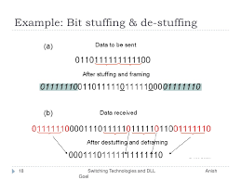
Data Link Layer Protocols

Slide 73
Data Link Layer Protocols
HDLC Address Field

Slide 74
Data Link Layer Protocols
HDLC Control Field

Slide 75
Data Link Layer Protocols
Poll/Final

Slide 76
Data Link Layer Protocols
HDLC Information Field

Slide 77
Data Link Layer Protocols
HDLC FCS Field

Slide 78
Data Link Layer Protocols

Slide 79
Data Link Layer Protocols
Use of P/F Field

Slide 80
Data Link Layer Protocols
Use of P/F Field

Slide 81
Data Link Layer Protocols
Use of P/F Field

Slide 82
Data Link Layer Protocols
Use of P/F Field

Slide 83
Data Link Layer Protocols
Use of P/F Field

Slide 84
Data Link Layer Protocols
U-Frame Control Field

Slide 85
Data Link Layer Protocols
Polling Example

Slide 86
Data Link Layer Protocols
Selecting Example

Slide 87
Data Link Layer Protocols
Peer-to-Peer Example

Slide 88
Data Link Layer Protocols
Peer-to-Peer Example

Slide 89
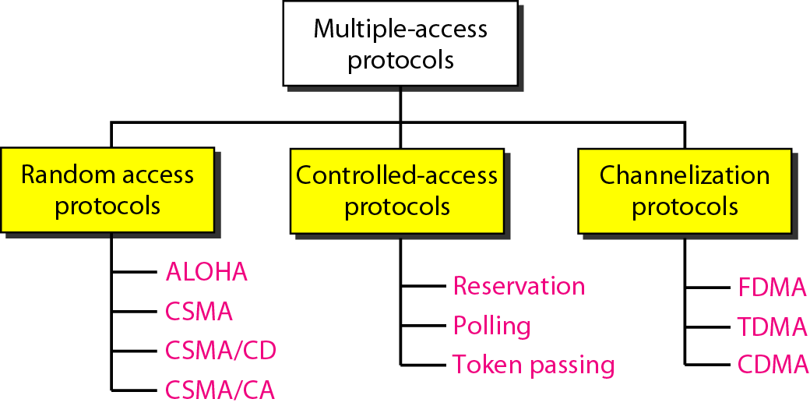
Multiple Access Protocols
Objective: Study about basic concept of Multiple Access Protocols

Slide 90
Multiple Access Protocols
RANDOM ACCESS Protocols
In random access or contention methods, no station is superior to another station and none is assigned the control over another. No station permits, or does not permit, another station to send. At each instance, a station that has data to send uses a procedure defined by the protocol to make a decision on whether or not to send.
ALOHA
Carrier Sense Multiple Access
Carrier Sense Multiple Access with Collision Detection
Carrier Sense Multiple Access with Collision Avoidance

Slide 91
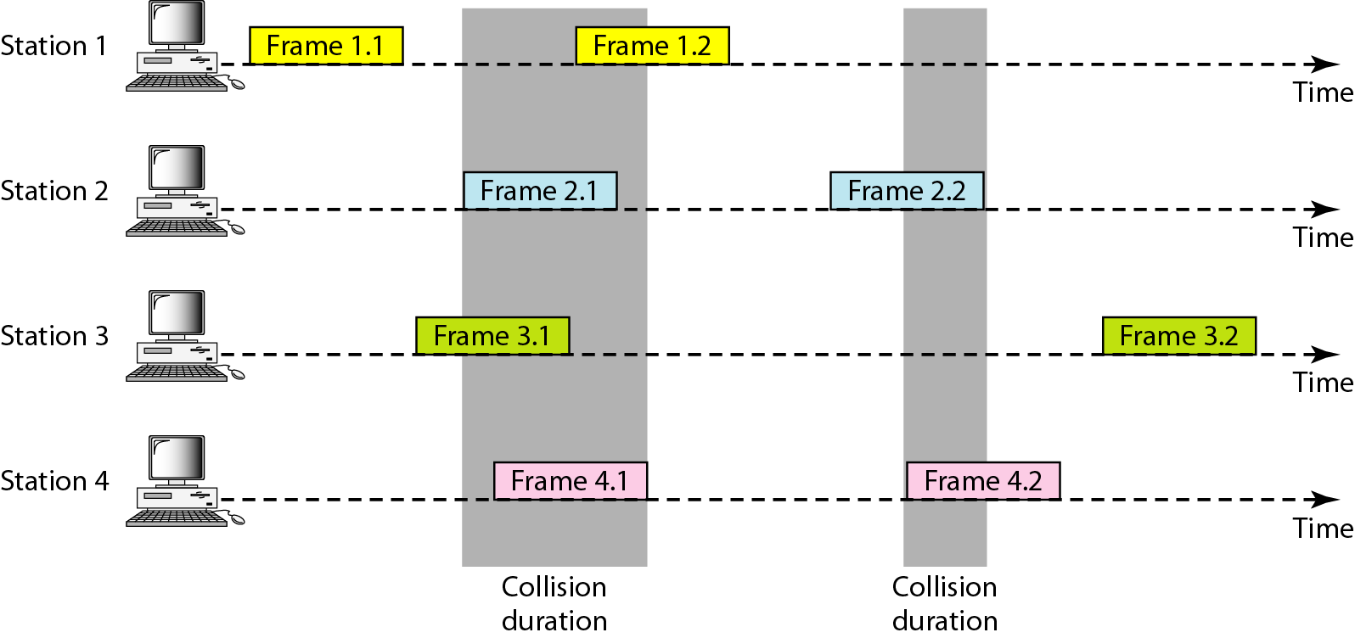
Multiple Access Protocols
Frames in a pure ALOHA network

Slide 92
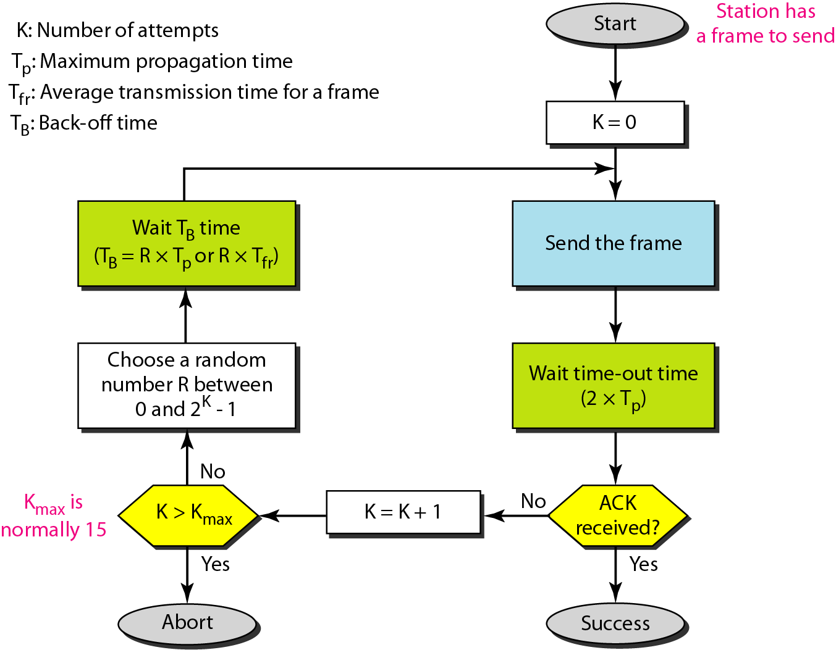
Multiple Access Protocols
Procedure for pure ALOHA protocol

Slide 93
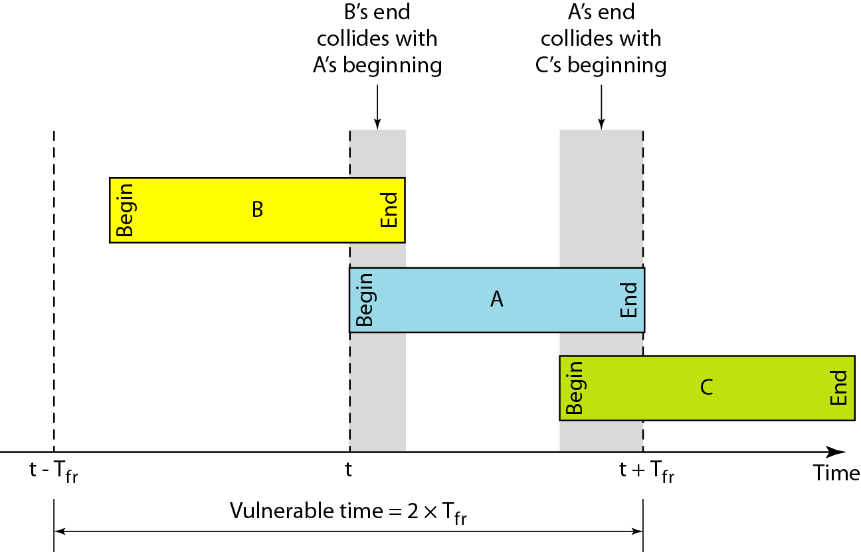
Multiple Access Protocols
Vulnerable time for pure ALOHA protocol

Slide 94
Multiple Access Protocols
The throughput for pure ALOHA is S = G × e ^{−2G} .
The maximum throughput
S_{max} = 0.184 when G= (1/2).

Slide 95
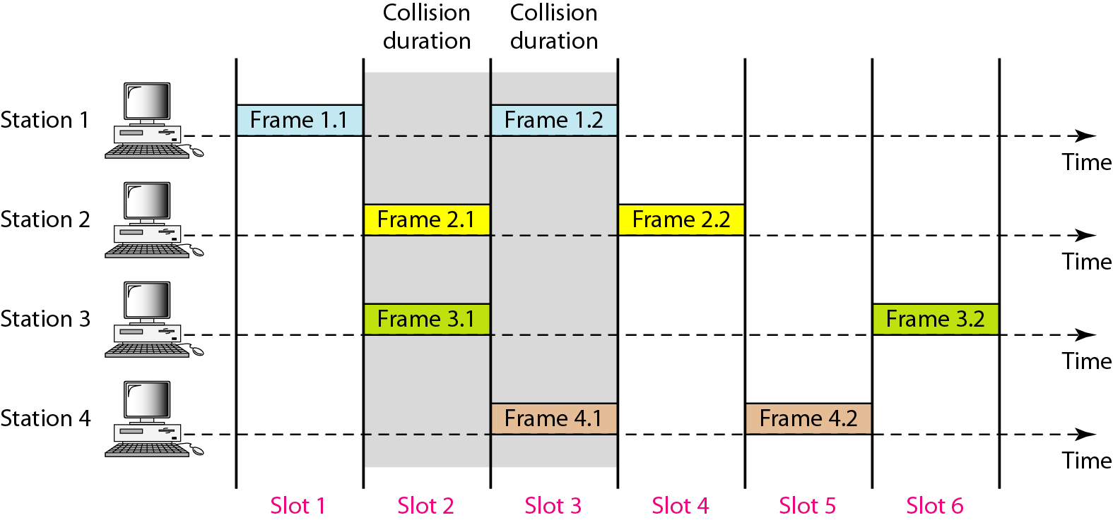
Multiple Access Protocols
Frames in a slotted ALOHA network

Slide 96
Multiple Access Protocols
The throughput for slotted ALOHA is S = G × e^{−G} .
The maximum throughput S_{max} = 0.368 when G = 1.

Slide 97
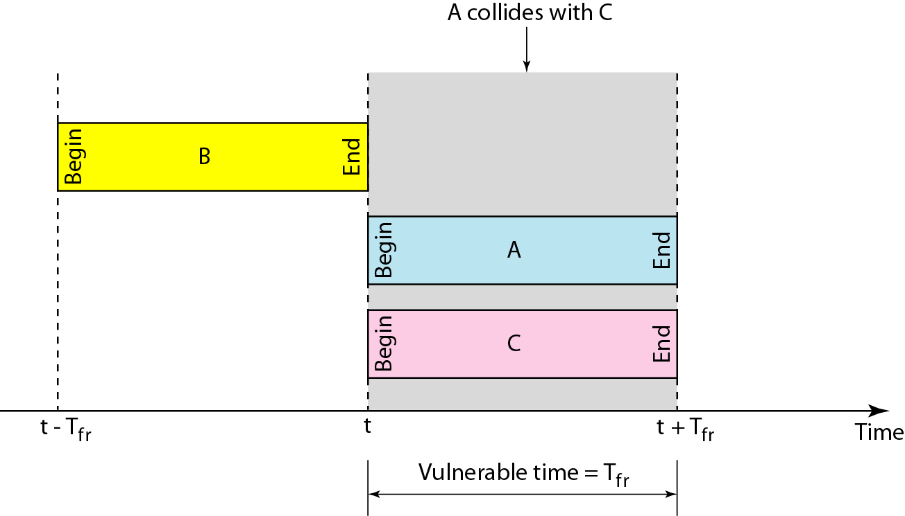
Multiple Access Protocols
Vulnerable time for slotted ALOHA protocol

Slide 98
Multiple Access Protocols
Random access protocol: Evolution of CSMA/CD

Slide 99
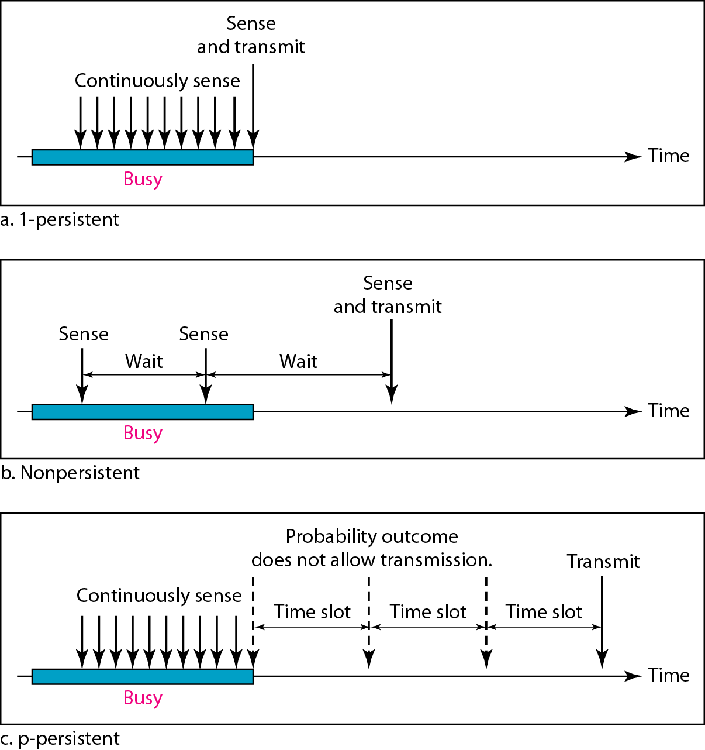
Multiple Access Protocols
Random access protocol: CSMA
Behavior of CSMA three persistence methods

Slide 100
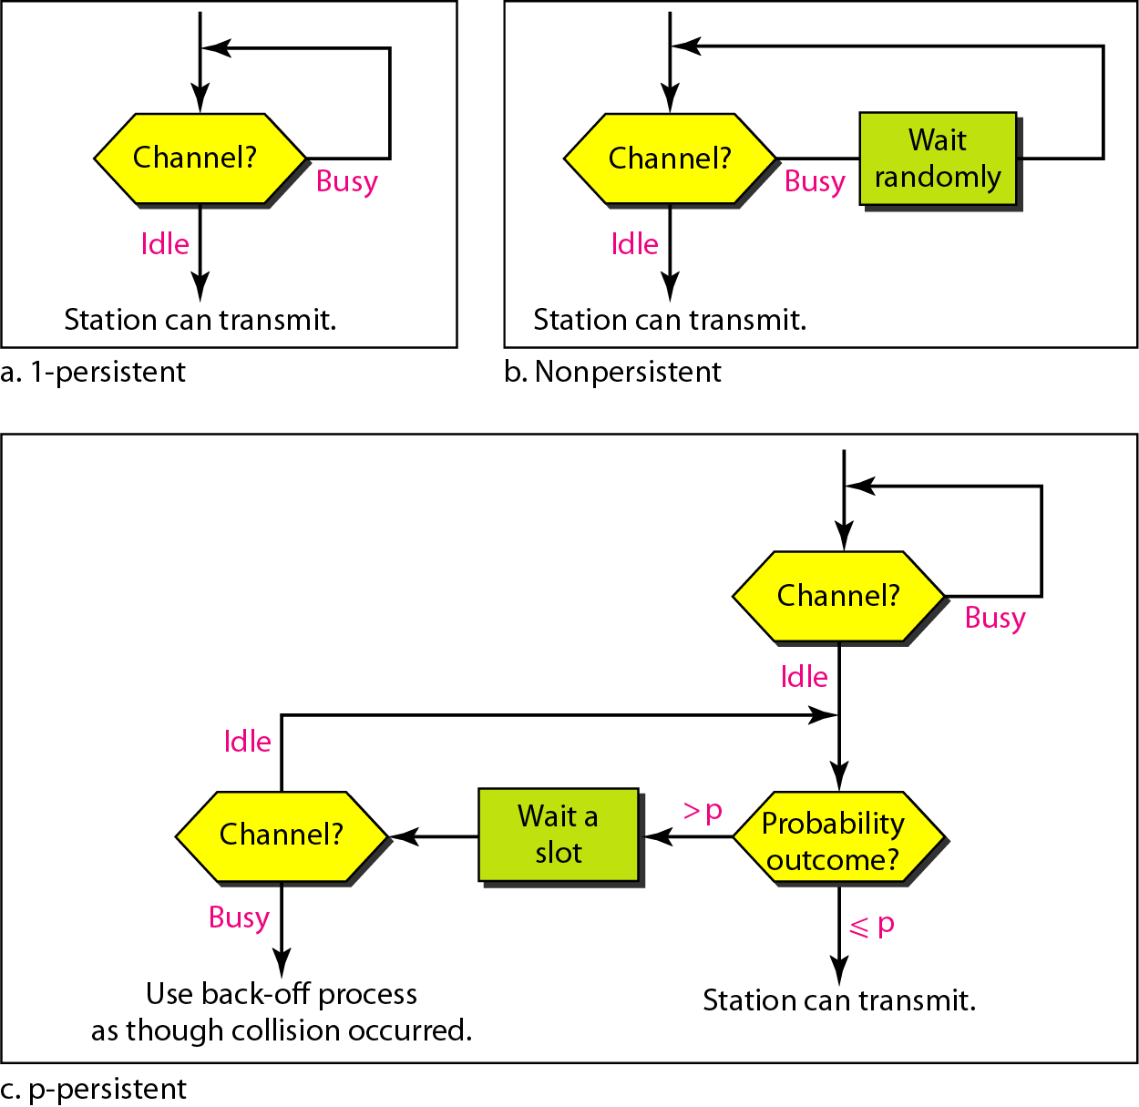
Multiple Access Protocols
Random access protocol: CSMA
Flow diagram for three persistence methods

Slide 101
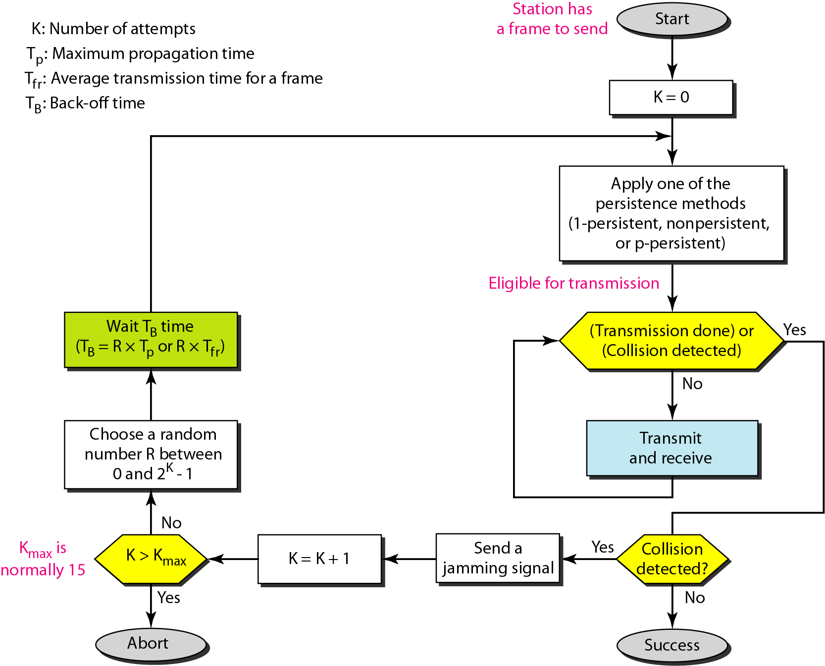
Multiple Access Protocols
Random access protocol: CSMA/CD
Flow diagram for the CSMA/CD

Slide 102
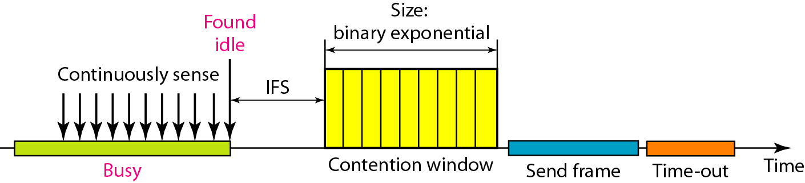
Multiple Access Protocols
Random access protocol: Evolution of CSMA/CA
Timing in CSMA/CA
In CSMA/CA, the IFS can also be used to define the priority of a station or a frame.
In CSMA/CA, if the station finds the channel busy, it does not restart the timer of the contention window; it stops the timer and restarts it when the channel becomes idle.

Slide 103
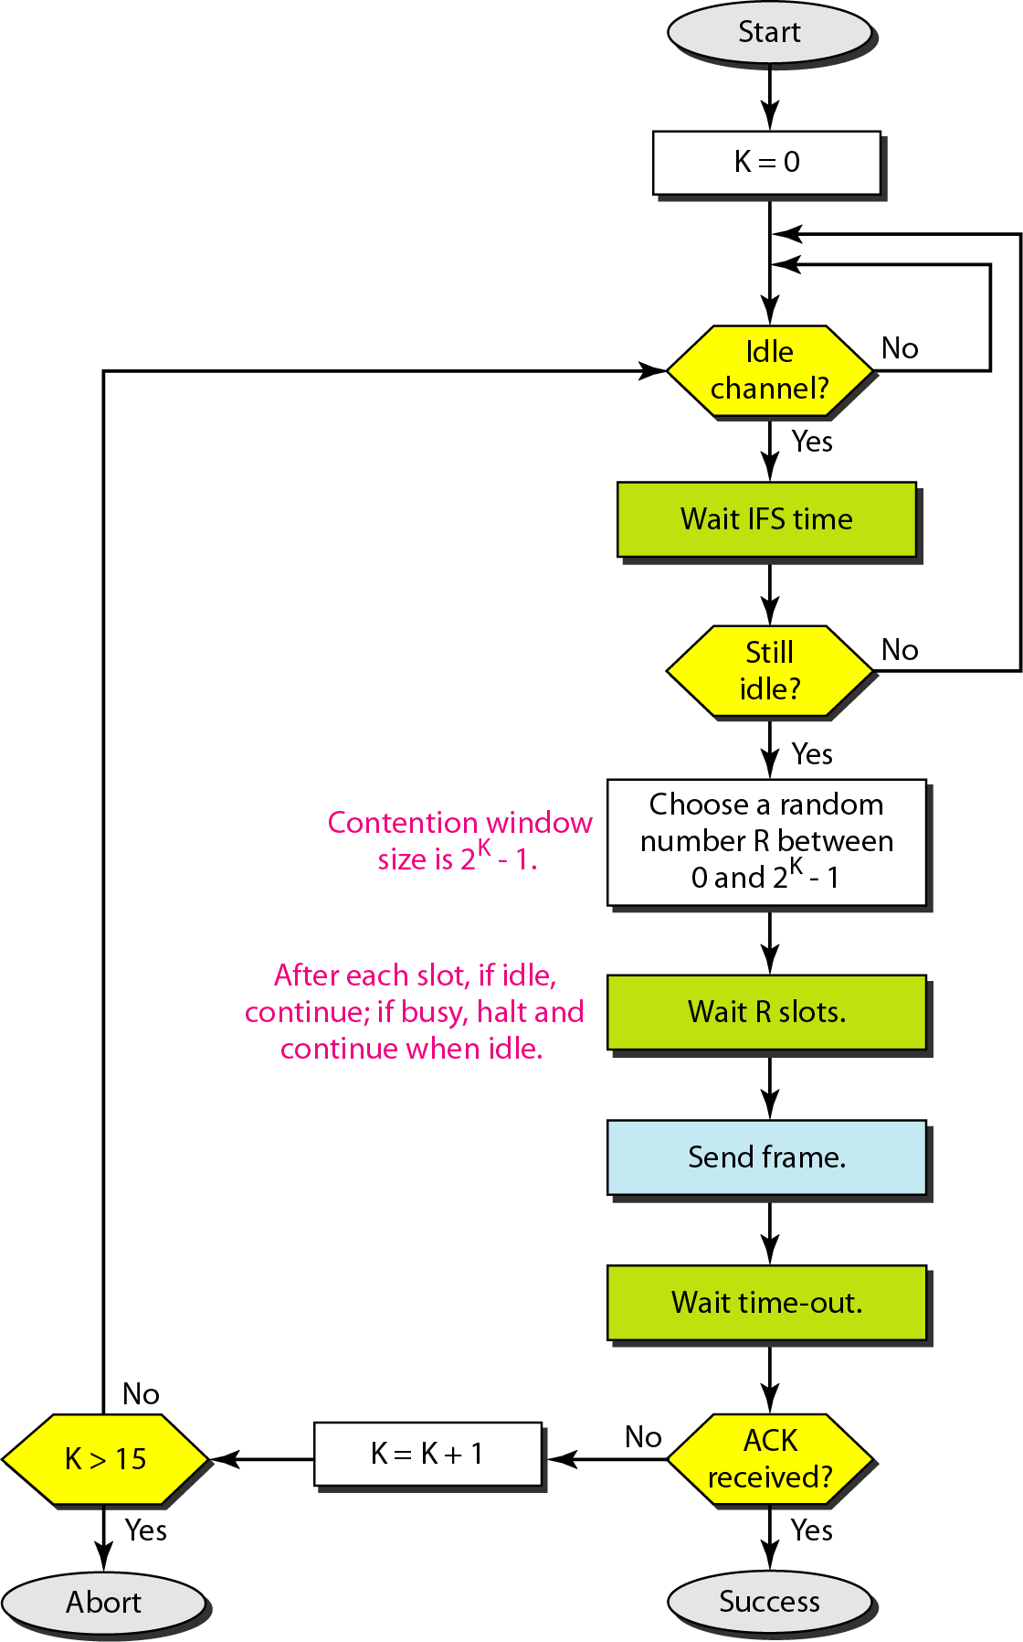
Multiple Access Protocols
Flow diagram for CSMA/CA

Slide 104
Multiple Access Protocols
CONTROLLED ACCESS
In controlled access, the stations consult one another to find which station has the right to send. A station cannot send unless it has been authorized by other stations. We discuss three popular controlled-access methods.
Reservation
Polling
Token Passing

Slide 105
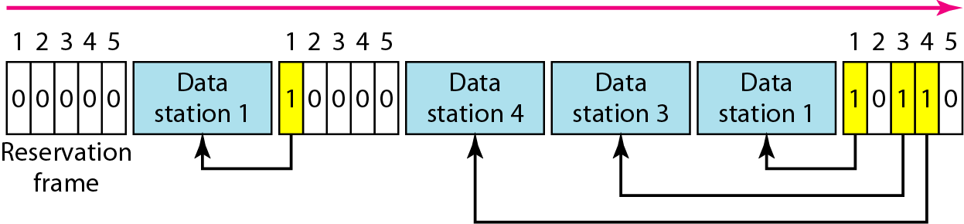
Multiple Access Protocols: Controlled Access
Reservation access method

Slide 106
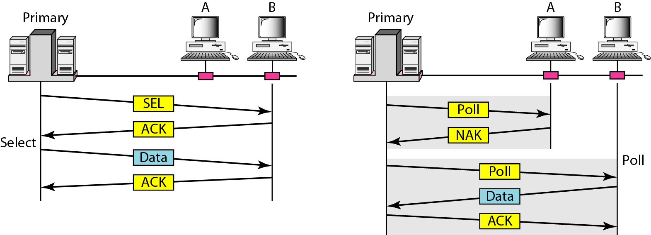
Multiple Access Protocols: Controlled Access
Select and poll functions in polling access method

Slide 107
Questions
A pure ALOHA network transmits 200-bit frames on a shared channel of 200 kbps. What is the requirement to make this frame collision-free?
Solution
Average frame transmission time T_{fr} is 200 bits/200 kbps or 1 ms. The vulnerable time is 2 × 1 ms = 2 ms. This means no station should send later than 1 ms before this station starts transmission and no station should start sending during the one 1-ms period that this station is sending.

Slide 108
A pure ALOHA network transmits 200-bit frames on a shared channel of 200 kbps. What is the throughput if the system (all stations together) produces
a. 1000 frames per second b. 500 frames per second
c. 250 frames per second.
Questions
Solution
The frame transmission time is 200/200 kbps or 1 ms.
a. If the system creates 1000 frames per second, this is 1 frame per millisecond. The load is 1. In this case S = G× e^{−2 G} or S = 0.135 (13.5 percent). This means that the throughput is 1000 × 0.135 = 135 frames. Only 135 frames out of 1000 will probably survive.

Slide 109
Solution cont…
b. If the system creates 500 frames per second, this is (1/2) frame per millisecond. The load is (1/2). In this case S = G × e ^{−2G} or S = 0.184 (18.4 percent). This means that the throughput is 500 × 0.184 = 92 and that only 92 frames out of 500 will probably survive. Note that this is the maximum throughput case, percentagewise.
c. If the system creates 250 frames per second, this is (1/4) frame per millisecond. The load is (1/4). In this case S = G × e −^{2G} or S = 0.152 (15.2 percent). This means that the throughput is 250 × 0.152 = 38. Only 38 frames out of 250 will probably survive.

Slide 110
Questions
A slotted ALOHA network transmits 200-bit frames on a shared channel of 200 kbps. What is the throughput if the system (all stations together) produces
a. 1000 frames per second b. 500 frames per second
c. 250 frames per second.
Solution
The frame transmission time is 200/200 kbps or 1 ms.
a. If the system creates 1000 frames per second, this is 1 frame per millisecond. The load is 1. In this case S = G× e^{−G} or S = 0.368 (36.8 percent). This means that the throughput is 1000 × 0.0368 = 368 frames. Only 386 frames out of 1000 will probably survive.

Slide 111
Questions
b. If the system creates 500 frames per second, this is (1/2) frame per millisecond. The load is (1/2). In this case S = G × e^{−G} or S = 0.303 (30.3 percent). This means that the throughput is 500 × 0.0303 = 151. Only 151 frames out of 500 will probably survive.
c. If the system creates 250 frames per second, this is (1/4) frame per millisecond. The load is (1/4). In this case S = G × e ^{−G} or S = 0.195 (19.5 percent). This means that the throughput is 250 × 0.195 = 49. Only 49 frames out of 250 will probably survive.

Slide 112
A network using CSMA/CD has a bandwidth of 10 Mbps. If the maximum propagation time (including the delays in the devices and ignoring the time needed to send a jamming signal, as we see later) is 25.6 μs, what is the minimum size of the frame?
Questions
Solution
The frame transmission time is T_{fr} = 2 × T_{p} = 51.2 μs. This means, in the worst case, a station needs to transmit for a period of 51.2 μs to detect the collision. The minimum size of the frame is 10 Mbps × 51.2 μs = 512 bits or 64 bytes. This is actually the minimum size of the frame for Standard Ethernet.

Slide 113
Flow Control
Objective: Study about basic concept of Flow control and its type.

Slide 114
Flow Control
Stop and Wait

Slide 115
Flow Control
Sender Sliding Window
Window size : n
Frame no. from: 0 to n
Window size : 7
Frame no. from 0 to 7

Slide 116
Flow Control
Receiver Sliding Window

Slide 117
Flow Control: Example sliding window
Sliding Window Example

Slide 118
Flow Control : Example sliding window
Sender

Slide 119
Flow Control : Example sliding window
Receiver

Slide 120
Flow Control and error control

Slide 121
Flow Control and error control:
Damaged Frame

Slide 122
Flow Control and error control

Slide 123
Flow Control and error control
Lost Frame

Slide 124
Flow Control and error control

Slide 125
Flow Control and error control

Slide 126
Error Detection and Correction
Objective: Study about basic concept of Error detection and correction methods
Types of Errors
Detection
Correction

Slide 127
Error Detection and Correction

Slide 128
Error Detection and Correction
Single-bit error

Slide 129
Error Detection and Correction
Multiple-bit error

Slide 130
Error Detection and Correction
Burst error

Slide 131
Error Detection and Correction
Error Detection and Correction
Redundancy

Slide 132
Error Detection and Correction
Error Detection and Correction

Slide 133
Error Detection and Correction
Error Detection and Correction
VRC

Slide 134
Error Detection
Error Detection and Correction
LRC

Slide 135
Error Detection
Error Detection and Correction
VRC and LRC

Slide 136
Error Detection
Error Detection and Correction
CRC :cyclic Redundancy check

Slide 137
Error Detection
Binary Division

Slide 138
Error Detection: CRC
Polynomial

Slide 139
Error Detection: CRC
Standard Polynomials

Slide 140
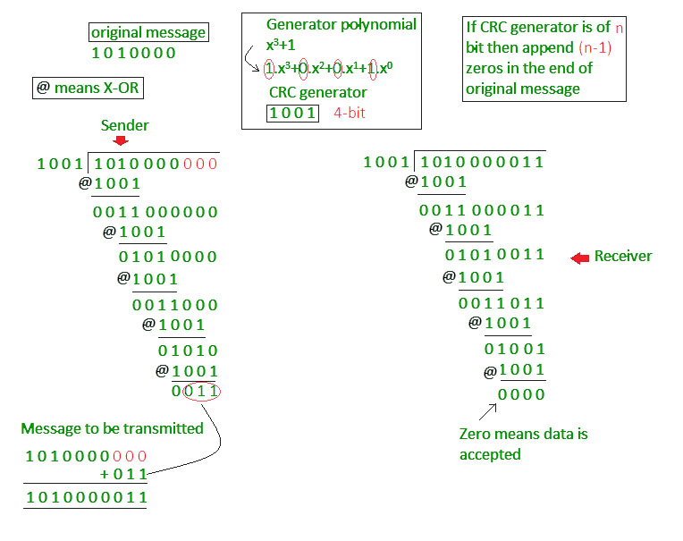
Error Detection: CRC

Slide 141
Error Detection: CRC
Error Detection: CRC
Checksum

Slide 142
Error Detection: CRC
Error Detection: CRC
Data Unit and Checksum

Slide 143
Error Detection and correction : hamming code

Slide 144
Error Detection and correction : hamming code
Hamming Code

Slide 145
Error Detection and correction : hamming code

Slide 146
Error Detection and correction : hamming code
Example of Hamming Code

Slide 147
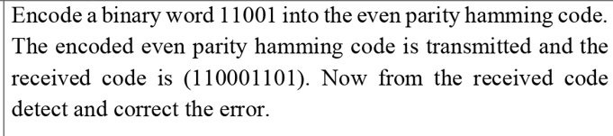

Slide 148
Error Detection: CRC
Error Detection and correction : hamming code
Error Detection and correction : hamming code
Single-bit error

Slide 149
Error Detection and correction : hamming code
Error
Detection

Slide 150
Faculty Video Links, Youtube & NPTEL Video Links and Online Courses Details
Youtube /other Video Links
https://www.youtube.com/watch?v=JFF2vJaN0Cw&list=PLxCzCOWd7aiGFBD2-2joCpWOLUrDLvVV_
https://www.youtube.com/watch?v=yNedVgNyE8Q
Sanjay Nayak CN KCS603 Unit Number 2

Slide 151
Daily Quiz
Let G(x) be the generator polynomial used for CRC checking. What is the condition that should be satisfied by G(x) to detect odd number of bits in error?
(A) G(x) contains more than two terms (B) G(x) does not divide 1+x^k, for any k not exceeding the frame length (C) 1+x is a factor of G(x) (D) G(x) has an odd number of terms.
2. Data link layer deal with data in the form of –
a. Bit b. Packet c. Frame d. Segment
3. In Bit stuffing we insert-------- after 00000.
a. 1 b. 0 c. 00 d. 11

Slide 152
Weekly Assignment
Daily Quiz
4. In Ethernet when Manchester encoding is used, the bit rate is:
(A) Half the baud rate. (B) Twice the baud rate. (C) Same as the baud rate. (D) None of the above
5. Which of the following is a MAC address? (A) 192.166.200.50 (B) 00056A:01A01A5CCA7FF60 (C) 568, Airport Road (D) 01:A5:BB:A7:FF:60
Pure and Slotted term related to which type of protocol-
a. CSMA b. ALOHA c. Token ring d. FDDI
7. IEEE 802.5 related to protocol-
a. Internetworking b. Ethernet c. Token ring d. Token Bus
8. IEEE 802.3 related to protocol-
a. Internetworking b. Ethernet c. Token ring d. Token Bus
9. Which combination is correct for IPv6 and IPv4 –
a. 48 & 32 b. 32 & 48 c. 128 & 48 d. 128 & 32
10.CRC method is –
a. Error Detection b. Error Correction c. Both d. None of above

Slide 153
Weekly Assignment
1. Name the functions of Data link layer (CO2)
2. Name the error control methods at data link layer. (CO2)
3. Explain the need of flow control. (CO2)
4. Calculate the frame transmission time for the frame length 30 bytes at the speed of 10Mbps. (CO2)
5. Name the IEEE standards for LAN.(CO2)
6. DQDB and FDDI standards.(CO2)
7. Explain the format of token in token ring topology. (CO2)
8. Explain the need of bit stuffing. (CO2)
9. find the checksum for the given data 1010000111001010(CO2)
20. Write the efficiency of pure aloha and slotted aloha protocol(CO2)
11. Calculate CRC code for given data 10011000 with given divisor x3+x2+1(CO2)
12. Calculate hamming code for the given 7 bit data 1101101. (CO2)

Slide 154
MCQ s
1.Sliding window ARQ generally implemented in (CO3)
Go-Back-N ARQ
Go-Reject-N ARQ
Selective reject ARQ
A &C
2. HDLC is an acronym for _______. (CO3)
High-duplex line communication
High-level data link control
Half-duplex digital link combination
Host double-level circuit

Slide 155
MCQ s
Which among the following represents the objectives/requirements of Data Link Layer? (CO3) a. Frame Synchronization b. Error & Flow Control c. Both a & b d. None of the above
4. Which feature of Go-Back-N ARQ mechanism possesses an ability to assign the sliding window in the forward direction? (CO3) a. Control Variables b. Sender Sliding Window c. Receiver Sliding Window d. Resending of frames

Slide 156
Expected Questions for University Exam
Compare CSMA, CSMA/CD and CSMA/CA (CO3)
Measurements of a pure aloha channel with a infinite no. of users show that 12% of the slots are idle. (CO3)
a) What is the offered load (G)
b) What is the throughput(S)
c) Is channel overload or under load.
Sanjay Nayak CN KCS603 Unit Number 2

Slide 157
Summary
In this unit we have discussed functions of data link layer and how the data is represent at data link layer using data link layer protocols.
How header is attached to the data received by network layer and error is detected and corrected at receiver site as well as flow control is managed so that receiver will not be overflow by data.

Slide 158
Recap of Unit
Functions of data link layer
Sub layers of data link layer
Project 802
PDU format,MAC frame
IEEE LAN standards
Ethernet
Token Ring
FDDI
DQDB
Data Link Layer Protocols
Multiple Access Protocol
Flow control
Error control

Slide 159
Old Question Papers
https://www.niet.co.in/pdf/previous-years/Vth-Semester-2023-2024/ACSE0502.pdf

Slide 160
References
Books:
Forouzen, "Data Communication and Networking",TMH
A.S. Tanenbaum, Computer Networks, Pearson Education
W. Stallings, Data and Computer Communication, MacmillanPress
Thank You

